Slide 1

How Does Being a Data Scientist Make a Difference in our Lives?
By LAJ
(Lien Lai, Abi Akinlotan, Jennifer Carden)

Slide 2


Jennifer Carden
Married with three kids.
All girls! Ages 8 (twins) and 17 months.
From Panama City FL but moved to Fargo ND last year.
I love a challenge and strive to apply 110% in everything I do.

Slide 3


Lien Lai
I am married with three kids.
Oldest is 18 yr, middle is 16 yr and youngest is 9 yr.
All Girls!
My sister and niece(who is 10 yr.) live with us.
We do everything together.
I have a BA in Arts
I’ve been working with children for the past 18 years.

Slide 4
What is a Data Scientist?
O’Neil, C., and Schutt, R. Doing Data Science
“More generally, a data scientist is someone who knows how to extract meaning from and interpret data, which requires both tools and methods from statistics and machine learning, as well as being human. She spends a lot of time in the process of collecting, cleaning, and munging data, because data is never clean.”
Shashi Upadhyay, CEO of Lattice
“Data Scientists are referred to as ‘UNICORNS’. They are professionals with a diverse skillset that is not commonly found in a single individual”

Slide 5

This Dataset contains information on ratings, average salaries, necessary skills, sector, location and industry requirements for the position of a Data Scientist

Slide 6
What skills are needed in Data Science?
Technical
Programing
Non-Technical
Strong Business Acumen
Knowledge of SAS and Other Analytical Tools
Adept at Working with Unstructured Data
Good Communication Skills
Great Data Intuition

Slide 7
What Does a Data Scientist Do?
Statistical analysis and computing
Process Large data sets
Machine Learning
Deep Learning
Data Visualization
Data Wrangling
Mathematics
Statistics
Programing
Big Data

Slide 8
How Will Data Science Better Our Future?

Slide 9
Working on the West Coast Vs. East Coast
West Coast Salaries
East Coast Salaries

Slide 10
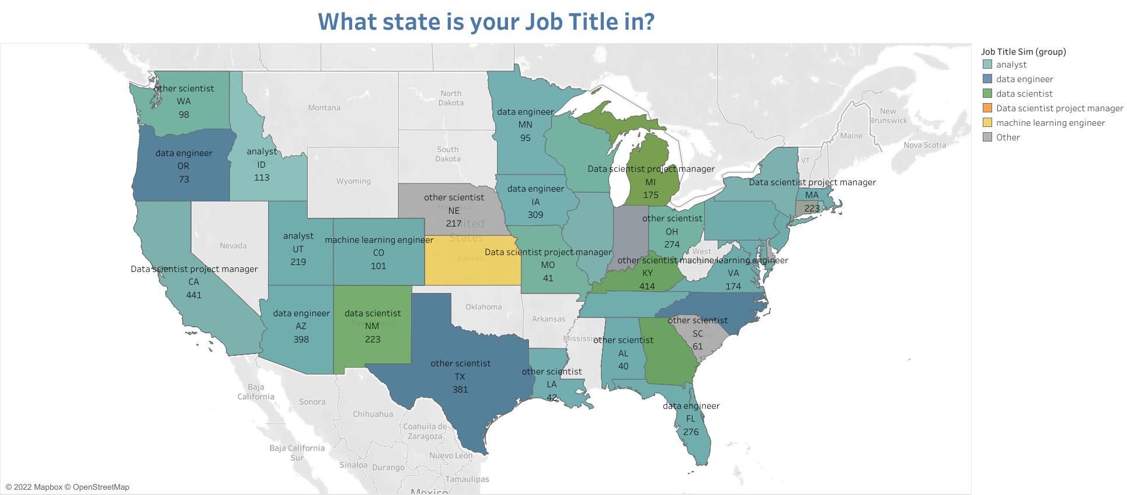
Job title

Slide 11
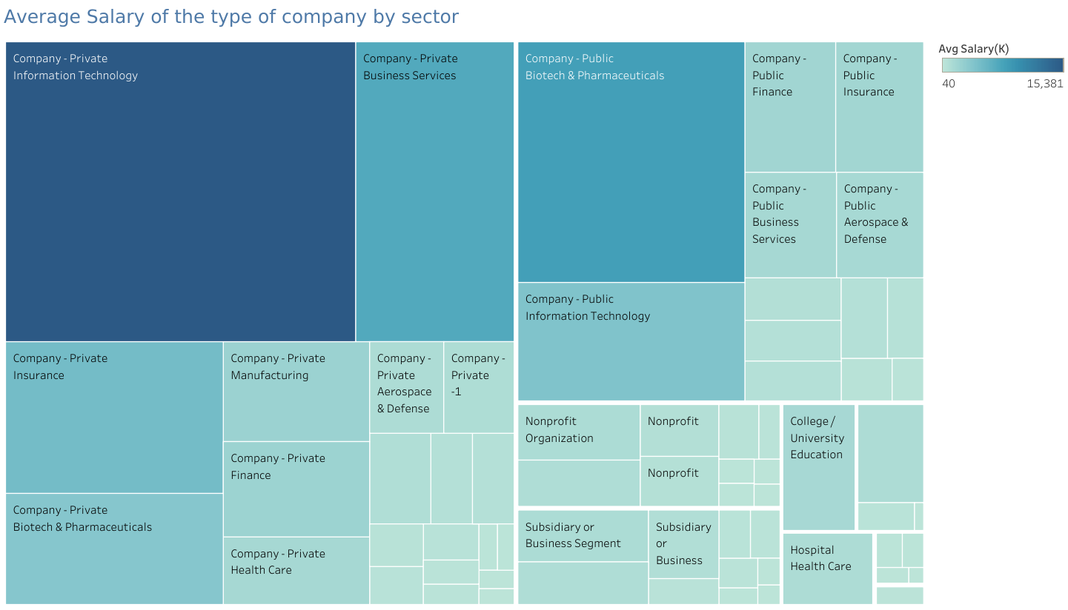
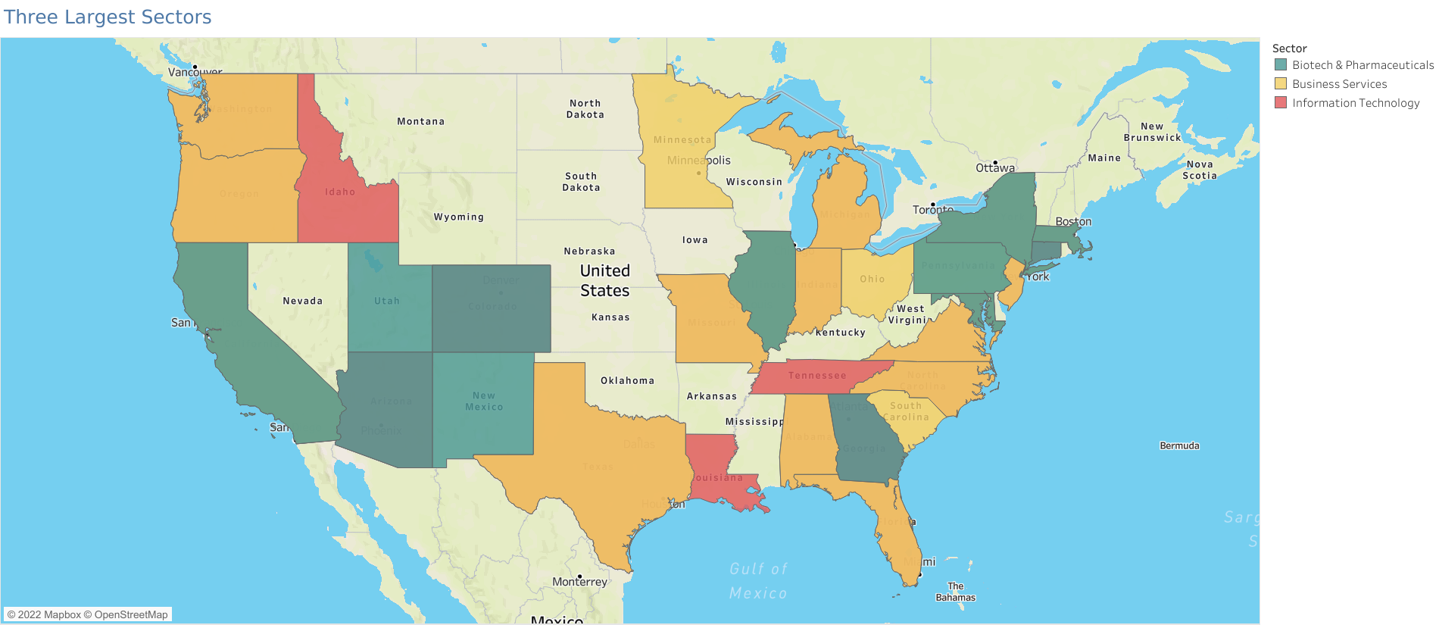
Which type of Company pays the most?
Where are the top three types located?

Slide 12
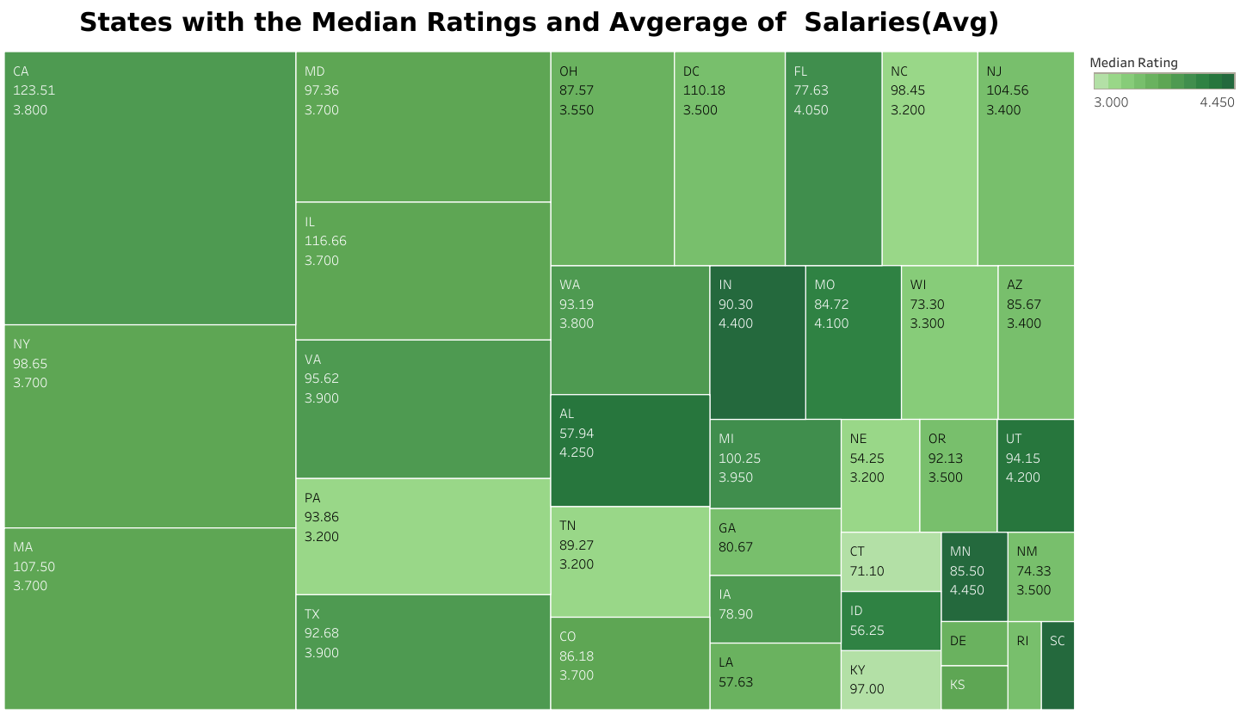
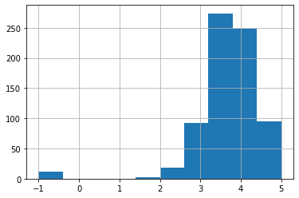
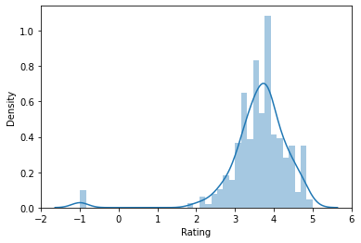
Majority of the companies have a rating between a 3 and 4.

Slide 13
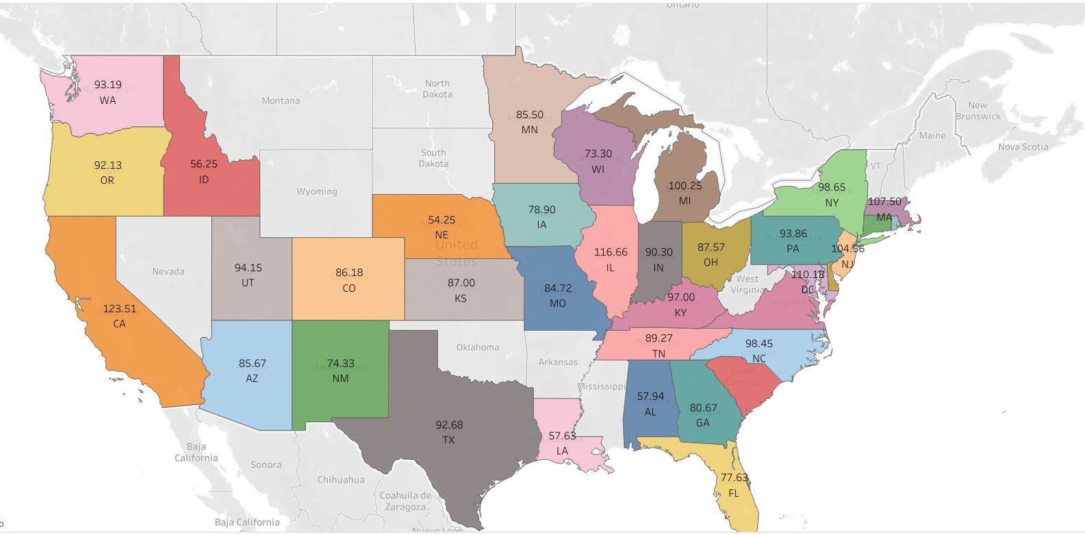
How much could a Data Scientist make?

Slide 14
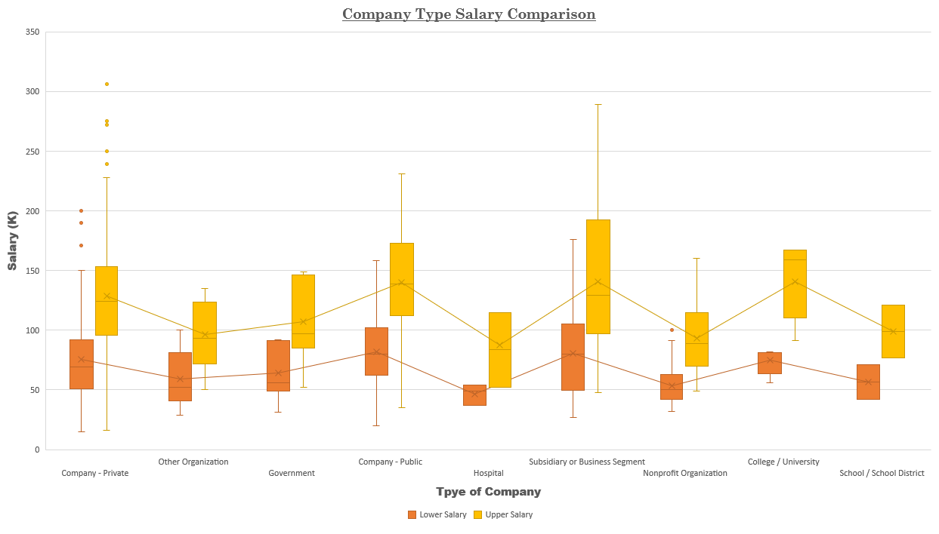

Slide 15
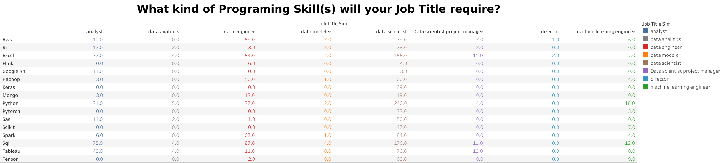

Slide 16
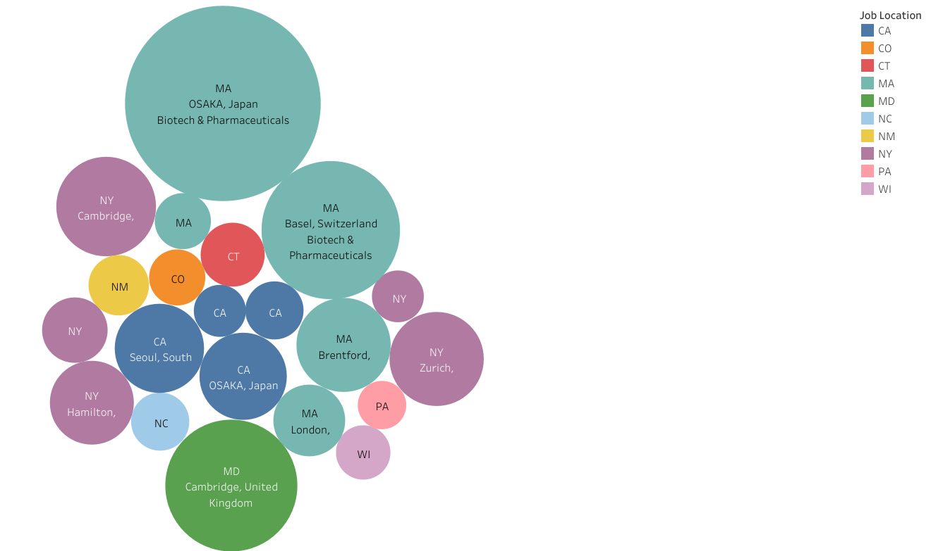
Bubble graph

Slide 17
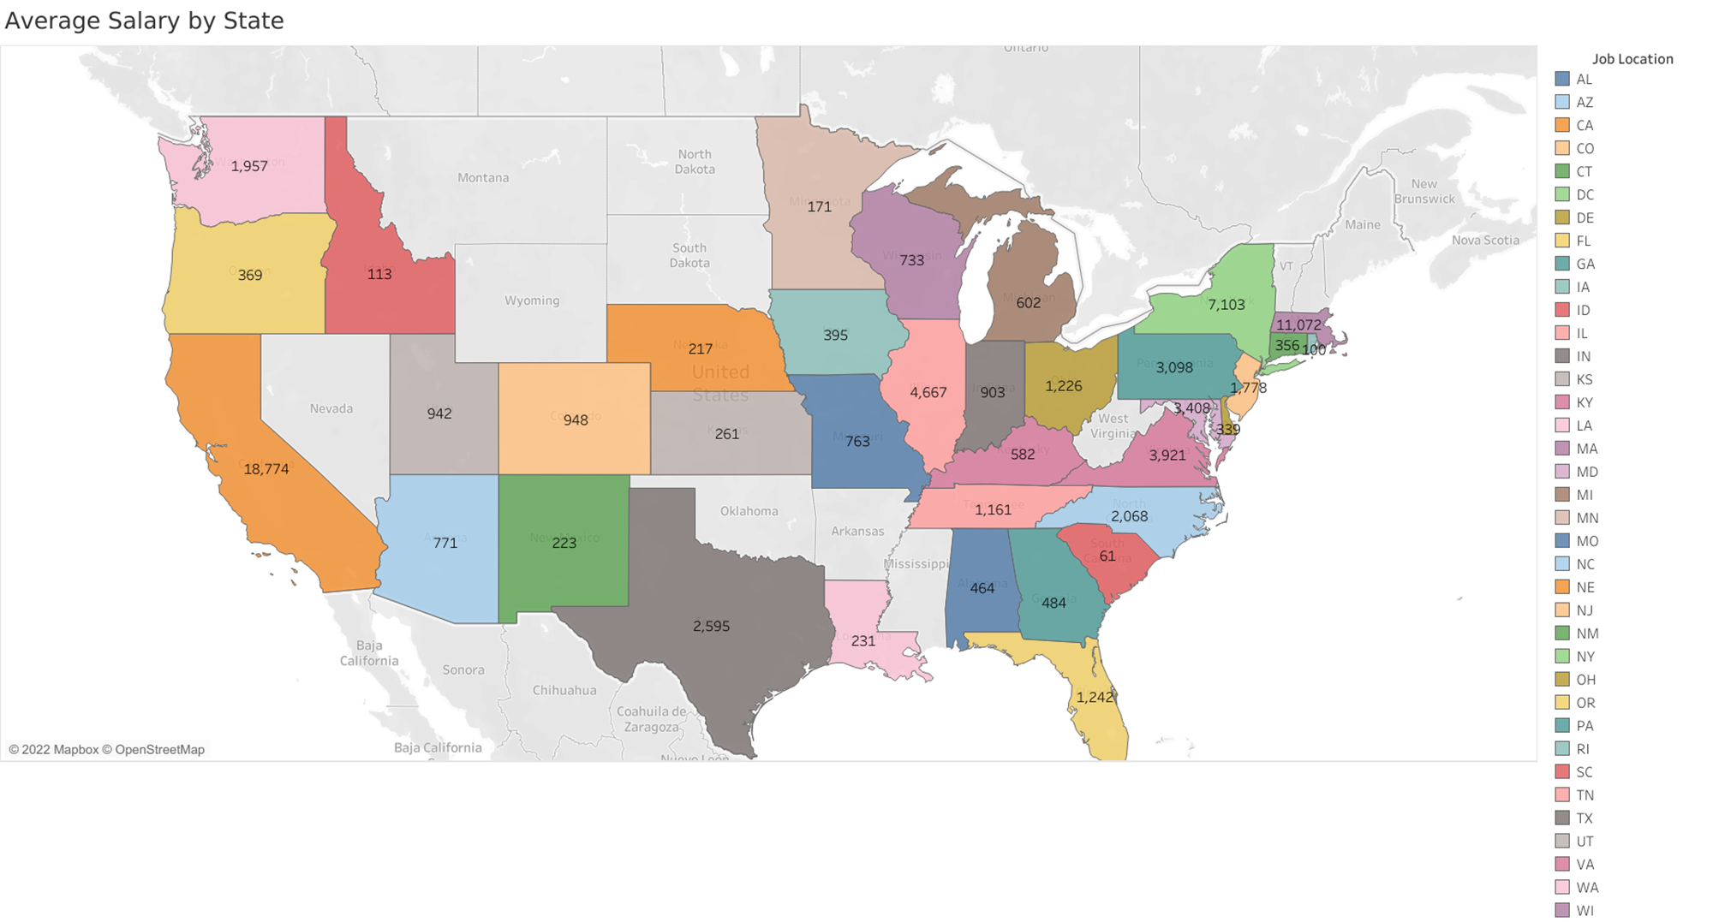
Avg Salary per State

